Slide 1
SSRR HOA Annual Meeting Agenda-April 27, 2025
1. Validate meeting quorum
2. Approval of last year’s minutes
3. Summary of Board actions last year
4. Introduction of new neighbors/changes to residents
5. Financial report & Dues, Unpaid 2024 and prior by property
6. Septic System Care & Maintenance: Peninsula Septic Service
Q&A
7. Safety : Crime Report & Surveillance Camera
8. Update: Fire Preparedness for Palos Verdes
9. Draft SSRR HOA Vision & Mission
10. Solicitation & Election of Board Members
11. Open forum

Slide 2
Accomplishments and Actions
Replaced old corroded metal electrical boxes at top of street with new plastic hardware.
Installed convex mirror at blind bend in the street.
Replaced camera wiring with armor-plated (insect and rodent resistant) wiring
Provided surveillance camera footage to residents to support crime investigations
Fully researched septic to sewer conversion project options, roadblocks and costs; met with city managers and others to determine feasibility and path forward. Documented and concluded that no further action on this topic will be pursued.
Held a successful Ice Cream Social in August that brought families and residents together
Replaced No Parking signs and large rocks at top of street to make clearer that parking is not allowed within ~200 feet of the entry to our street (on either side).
Greet new residents (renters or new homeowners)
Act as a clearinghouse to help neighbors communicate with each other. For example,
Helped get some trees that were overhanging the street trimmed by working with the neighbor.
Send out communications about animals/pets (e.g. dog bites, stray cats, etc)
Continue to publish an annual street directory and maintain communication with all residents and homeowners

Slide 3
Accomplishments and Actions
Offer updates on important topics for the neighborhood (e.g. new state regulations about ADU’s, septic tank maintenance, neighborhood safety and security).
Document and alert neighbors to the appropriate processes to use when faced with “Mission Prep” issues/concerns
Participated the Counsel of HOAs

Slide 4
Septic Questions
Do septic systems need to be treated periodically with chemicals?
What do I do if I smell an odor emanating from drain?
Are there any cleaning products that should not be used to clean a toilet?
What are the problems that occur in septic systems that are 50+ years old?
Explain code compliance requirements when selling a or retrofitting a home
Explain gray water systems and segregation of waste streams.
What are the steps to install new or replacement septic system?

Slide 5
Palos Verdes Fire Preparedness
April 27, 2025

Slide 6
Background
Much of the Palos Verdes Peninsula is considered a Very High Fire Hazard Severity Zone
However, Sunnyside and Sol Vista lie just outside the current border line of the Moderately Severe Fire Hazard Zone (see map slide 6)
While we are no longer in the high severity zones, all residences in PV are required to maintain a Defensible Space around all structures.
LA County Fire has undertaken Several Fire Prevention/Mitigation Measures (slide 3), and offer Home Hardening tips (slide 4)
Housing Inspections of Individual Homeowner Compliance will be conducted in June

Slide 7
LA County Fire Prevention Measures
Helopod near City Hall with a 7,000 gallon capacity/autofill
Canadian SuperScoopers – 16,000 gallon capacity
Two fire patrols for Palos Verdes: fire trucks and water tender
Pano AI cameras used to detect smoke
During a risk of fire additional staff will supplement existing assigned personnel
All LA County fire engines have the capacity to pump water from swimming pools

Slide 8
Home Hardening
Roof (clean) and rain gutters (clear debris)
Close any gaps in roof/structure where embers can enter
Remove hazards within 5 feet of structure: debris, dead plants, outdoor furniture, wood mulch, firewood
Exterior doors: make sure thresholds and weather stripping is tight
Open eaves: calk/plug any cracks
Vents: usually covered with ¼” screen. Upgrade to 1/8” screen

Slide 9
Fire Event
Apps you should have:
Myshake-earthquake
MyRPV-city info/alerts
Text “alertsb” to 888-777 for PV alerts
Check you zone at PVReady.gov: so you know your escape route
Have a “go bag” ready
Be ready for immediate evacuation
Go early: avoid congestion

Slide 10
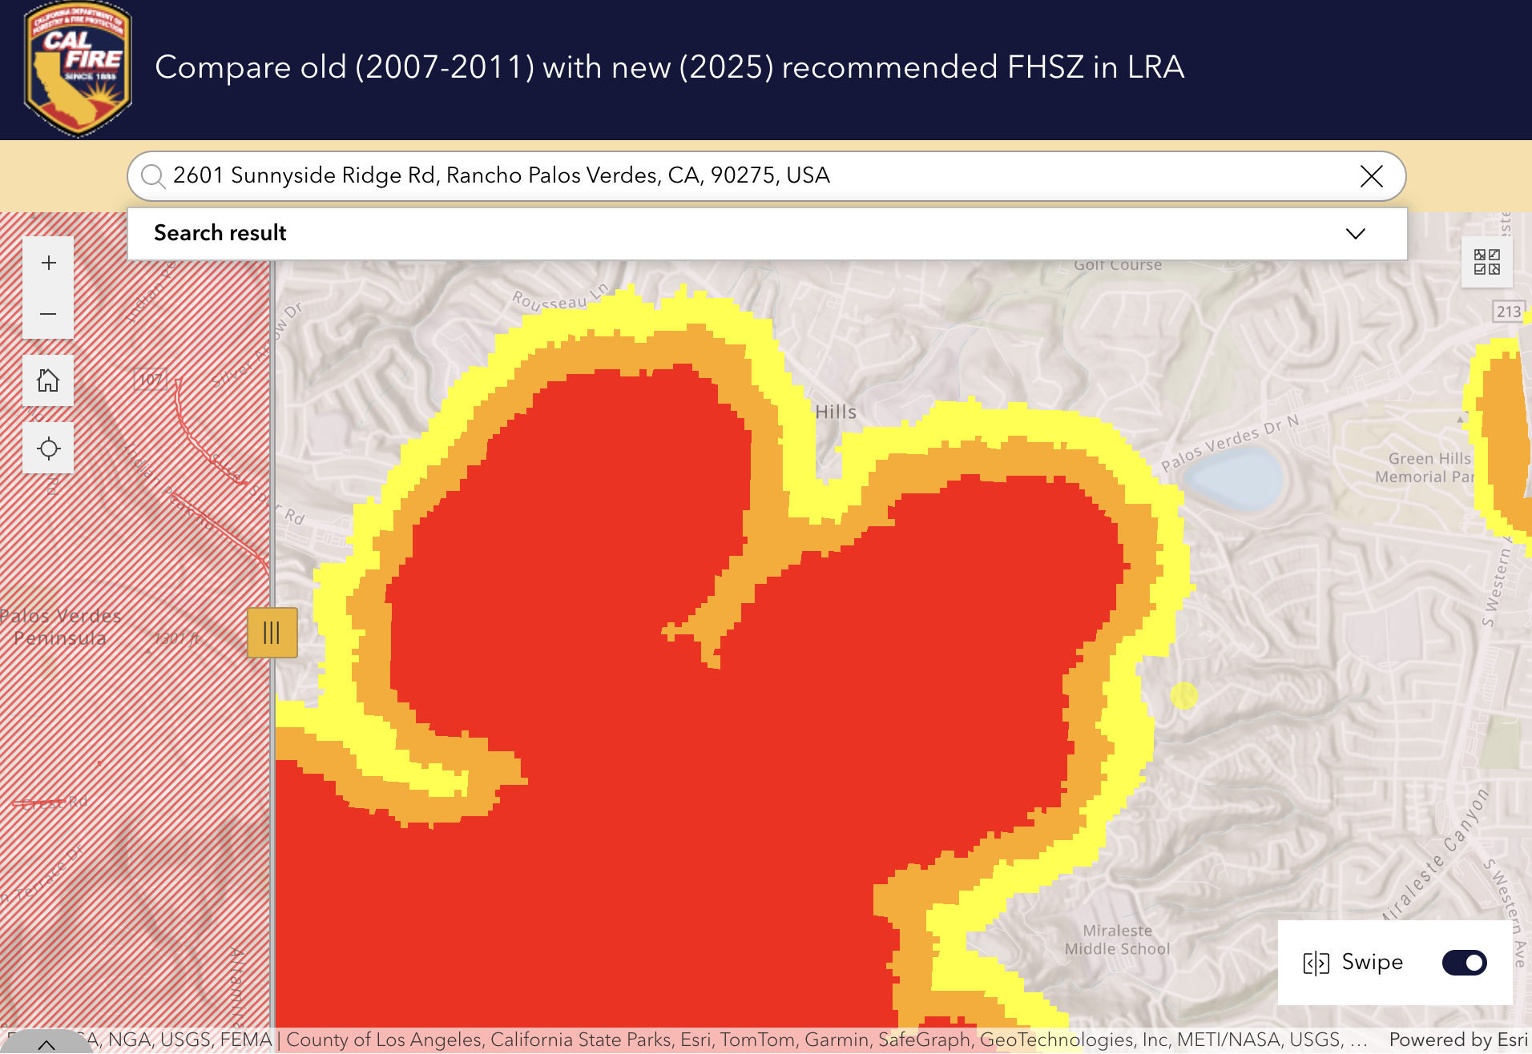
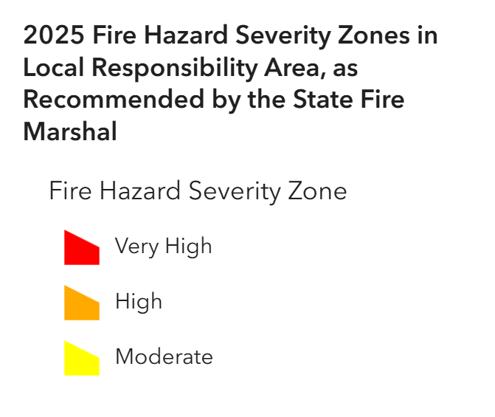
Palos Verdes Fire Hazard Zone
Sunnyside Ridge is no longer in any Fire Hazard Severity Zone. Note: we are very close to the Moderate Zone.
Homeowner’s Insurance:
Don’t take any action
that would jeopardize your renewal
2601 SSRR

Slide 11
For More Information
Review County of LA Annual Brush Clearance Notice
Review Annual Brush Clearance Requirements, watch videos and become familiar with the regulations
Access the LA County Fire Defensible Space Booklet
https://fire.lacounty.gov/wp-content/uploads/2021/05/Defensible-Space-booklet-2021WEB.pdf

